Slide 1

June 19, 2019
www.impact100essex.org
Questions? grants@impact100essex.org
Notes:
Introduce ourselves - members of both Impact100 and the Essex County Non-profit community.
Today we have our Impact100 hats on

Slide 2
Today’s Objectives
Clarity on Application Process, Guidelines
Collective Feedback to Potential Applicants
Agenda
Overview of Impact100 Essex
Timeline
Eligibility Requirements
SMART Goals
General Feedback
Q&A
Notes:
Introductions of members in teh room

Slide 3
What is
Simple Concept: At least 100 women
joining funds to create a community impact through Essex County non-profits

Slide 4

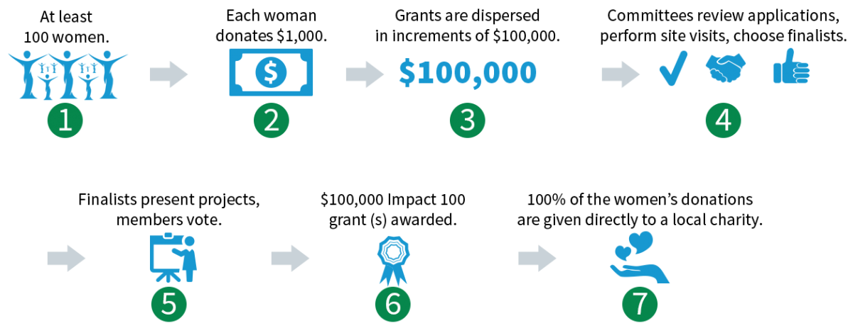
How Does it Work?

Slide 5

We are not alone…
There are more than 70 other chapters of Impact 100 in the U.S. and Australia including 4 in NJ!
By the end of 2017, Impact Groups in the U.S. had granted more than $55 million, and that number is growing
In 2017, Impact Chapters Gave away more than $10 million
As we grow as an organization, we will be able to give additional grants.
Impact100 Essex is completely independent – we decide how we operate, and we will adjust as time goes on, according to the needs of Essex County

Slide 6
Previous Applicants and Grantees
2017
Covenant House - Financial Literacy
Music and the Brain -
Expansion
Prevent Child Abuse NJ
Pilot Program
Spectrum 360
Partnership/greenhouse
2018
Schools that Can - Expansion
Community Food Bank of NJ - Partnership/Initiative
Imagine - free support center
NJ Tree Foundation
Expansion
Notes:
every year is different which is why we don’t give direct feedback. Every year we have different readers.

Slide 7


Last year’s Grant Recipient: Schools That Can Newark

Slide 8

Timeline

Slide 9
Grants Timeline 2019
June 20
Application Available
June 19
Applicant Info Session
Waterfront Recreation Center
2 Grafton Ave,
Newark
10am-12pm
September 12
Applications Due
Grant Committee reviews applications
September-October
Site Visits of semi-finalists
October 31-November 13
June 19 Applicant Info Session
Finalists notified December 6
Finalists prepare presentations
Sept. 12 Application Due
Membership Meeting
Jan 21, 2020
Finalist Presentations
Members Vote
2019 Grantee Announced
Sept-Nov Review
December Finalists
Jan 21 2020

Slide 10

Eligibility Requirements
Notes:
Does your organization fit our eligiblity requirements?

Slide 11
Organizations must operate within Essex County, NJ, and:
Be a 501 (c)(3)
Have a Track record of success
Be in operation at least 3 years
Have an annual operating budget of at least $100,000
Have at least 2 years of independently prepared financial statements
Notes:
MAYURI 11-18 slides

Slide 12
We Are Looking For:
Projects in Essex County with high impact – new projects or expansion of existing projects
Projects addressing under-met needs, empowering an underserved constituency
Projects that innovate, deepen or expand an existing mission, resulting in measurable, sustainable change
A Plan to spend the grant within 2 years, and evidence that all funding needs will be met.
Evidence that the idea is effective – show us your research!

Slide 13
We Are NOT Looking For:
Lobbying, Partisan, Religious Projects
Debt, Education, Interim Bridge Funding, Endowments
General Operating Expenses
Grants to Individuals

Slide 14
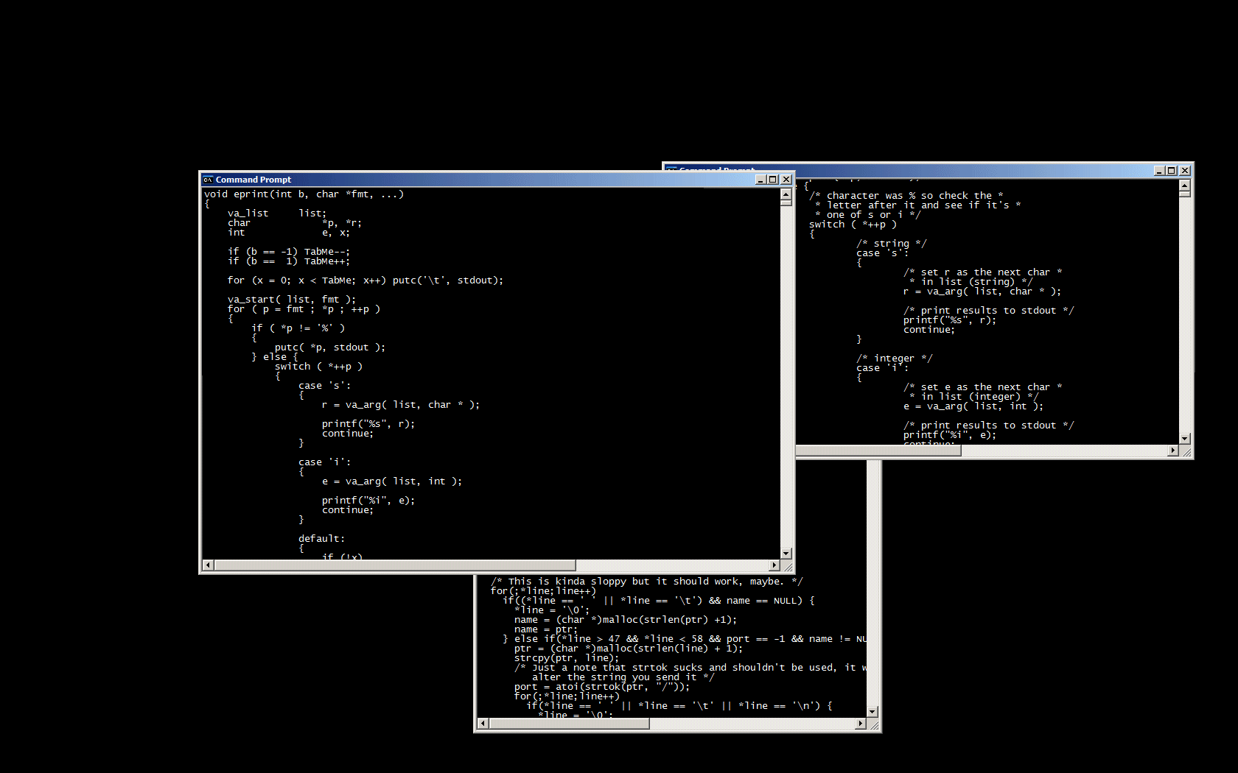
Application Review

Slide 15
Project Title/Name and one sentence description
Statement of Need
Summarize the challenge your project aims to solve. Cite and share data that helps to frame the challenge. Are you looking for data?
Project Summary
Provide an overview of the project. Include how this project will take your work in the community to the next level and the impact you expect as a result. Inspire us!
Notes:
Try the new Opportunity Atlas - www.opportunityatlas.org

Slide 16
Sustainability How would the project sustain itself after two years if you receive Impact100 Essex funding?
Why You? Describe how your organization is well positioned to succeed with this project based on current programs and past accomplishments

Slide 17
Project Budget
the total project budget with a detailed use of funds and show how the funds will be allocated within no more than a two-year time frame (one year is fine). If you have overhead, denote the percentage and amount.
source of other revenue including indication of what is already acquired and what needs to be acquired.
a small narrative to accompany your budget that includes
any explanation that might be needed to clarify items in your budget attachment;
a description of how Impact100 Essex’s funds will be used for this project;
an indication if the cost of assessing the program as you described in the evaluation section will be covered by this grant or with other funds; and
a statement of whether or not you need additional resources to begin this project and if additional resources are needed, please explain what those resources are, quantify them as appropriate, and describe how and when you intend to obtain them.
Notes:
Two years financials - best is operating statements and balance sheet with notes (unaudited is okay).
The Form 990 is not a good substitution
Detailed Budget.

Slide 18
Readiness: We hope to see our funds quickly begin to impact Essex County. If you received these funds around February 2020, is there anything that might prevent you from beginning the project immediately? Examples include but are not limited to: permits for renovations/construction, approvals, permissions from School Boards or Unions, new hires.
Notes:
While smart goals do not ask for outcome measure

Slide 19
Project Goals/Deliverables/Impacts
Please share your SMART goal(s) for this project here (Specific, Measurable, Attainable, Relevant and Time-bound)
- Please provide a list of deliverables and timelines that align with the SMART Goals. * 1-2 years max
Rationale: Please share why you have chosen this particular approach or strategy to address the challenge you discussed in your statement of need. For example, are you launching an approach locally that has demonstrated success elsewhere? Are you trying an innovative approach to an intractable problem?
- What will be the long term impact of your project?
Notes:
big picture - we are looking for SMART Goals aligned with timeline, deliverables and outcome measures.

Slide 20
Project Evaluation Define how you will measure success. How will we know if the program has or is on target to achieve the impact you have described?
For each SMART goal show:
Process measures and how you measure them.
Indicators you will use to measure the project’s intermediate and/or long-term outcomes.
Notes:
1) Your process measures and how will you measure them. Process measures address the activities and outputs. For example, what staff do (i.e. trainings, service delivery, project management) how many people they serve, how many hours of service they deliver or stages of completion of a project or the percentage of students who needed and received tutoring, for example.
2) Indicators you will use to measure the project’s intermediate and/or long term Outcomes. An outcome is the “changes in the lives of individuals, families, organizations, or the community as a result of the program” and an indicator is “the specific, measurable information collected to track whether an outcome has actually occurred” (Source http://strengtheningnonprofits.org/resources/guidebooks/MeasuringOutcomes.pdf)

Slide 21
SMART GOALS

Slide 22

Who has written a goal you couldn’t complete?

Slide 23

S.M.A.R.T. Goals are:
Easy to understand
Achievable
Clear Point of Success

Slide 24
S.M.A.R.T Goals are:
Specific
Measurable
Attainable
Relevant
Time bound

Slide 25
Specific
The goal must clearly state what is to be achieved, by whom, where and when it is to be achieved.
Sometimes it may even state why that goal is important.
NOTE: Not all of these questions will apply to every goal … but it is important to ask all the questions in order make it as clear as possible.

Slide 26
Measureable
It answers the question of quantity - how much, how often, how many?
Measurability applies to both the end result and the milestones along the way to attaining a goal.
The milestones are signs along the way that will tell you that you are on the right track to achieving your goal.

Slide 27
Attainable
Goals must be achievable or attainable.
If you set goals that even you don’t believe in it is very unlikely you will achieve them.
This is equally important when setting goals for a group, such as a team
The process of setting S.M.A.R.T. goals ensures that the necessary buy-in to the goals is in place
NOTE: While the goals must be possible, be careful that you do not limit yourself based on what other people believe to be achievable

Slide 28
Relevant
Your goals must be relevant to what you want to achieve in the short term and the long term.
Understanding your organization’s or personal vision, mission and purpose is critical in this respect.
Do those things that are most important and in line with your long term vision and mission.

Slide 29
Time-Based
This sometimes overlaps with the goal being Specific, but it aims to ensure that you put a time-frame to your goals.
Deciding by when you want to achieve something can be a good motivator. It can prevent you from procrastinating because you know that you are working to a deadline.
NOTE: Someone said a goal is a dream with a time-frame to it

Slide 30
S.M.A.R.T. Goal Setting - Template
 | Big Vision | Specific | Measureable | Attainable | Relevant | Time-Based
Prompting Questions 🡪 | What do you want to achieve? | Who? What? Why? Where? | How Much? How Often? How Many? | Is this achievable? | How is it important to what you want to ultimately achieve? | By When?
S.M.A.R.T. Goal #1
S.M.A.R.T. Goal #2
Pair and Share - Draft initial S.M.A.R.T. goals

Slide 31
Schools That Can SMART GOAL
Goal: By December 2020, STC Newark will have expanded the Career Skills Program to two additional high schools so that cohorts of at least 15 students per class year in each school (totaling over 200 Newark students per year) will be participating in robust career and technical education programs in their schools, preparing them for middle-skill, in-demand careers upon their future high school graduation, thus curtailing cycles of poverty for some students while filling regional labor market demands with qualified Newark talent.
Notes:
Specific - expanded the career skills program
Measurable - 2 HS with 15 students per class = 200
Attainable
Relevant
time Bound - by December 2020

Slide 32
Modified Exemplar from Applicant
Goal 1: By January 31, 2020, 10 organizations and X staff will adopt and implement XXX Principles
Goal 2: By January 31, 2020, 100 community members from the participating organizations will adopt and implement the XXX principle
Goal 3: By January 31, 2020, 500 children from the participating organizations will be impacted by this XXX Initiative and will build skills they learn from the staff and curriculum and materials.

Slide 33

General Feedback
Notes:
We don’t give individual feedback but here is general feedback
Membership is diverse in every sense of the word - not professional foundation, group of women,

Slide 34
Finalists and Semi-Finalists in 2017 and 2018:
Educated us on the issues or policies
Clearly demonstrated need
Showed us why they were the organization to meet that need
Showed us they were ready to get to work
Had clear detailed budgets, program and evaluation plans
Gave us confidence that they could handle the additional work and money
Notes:
Grant writer needs to convey the impact and import of your application - to someone who does not practice in your field (all the issues involved)
Educate us
Use data to make that point
Empathy
Use Period Initiative as an example of educating us/empathy, partners were lined up, easy to implement
Schools that Can application - well positioned, experienced, well partnered, expanding what works - explained data on workers and jobs

Slide 35

INSPIRE US!
Notes:
Remember that this is not a typical grant. This is a group of diverse women from around Essex County. We are not a foundation. This is as much art as it is science.

Slide 36
Projects did not advance when:
We weren’t sure what the project was, specifically
We weren’t sure where/how they planned to spend the money
The request seemed to continue ongoing operations
Necessary partners and/or additional funding were not yet identified, clarified or secured
Funding seemed unnecessary
Staffing seemed inadequate, or there was not a clear plan to achieve needed staffing
Evaluation was not thoroughly described/defined
The impact/change wasn’t apparent

Slide 37

Q&A

Slide 38
Please stay tuned for application link/upload and thank you for being here today!

