Slide 1
www.impact100essex.org
Questions? grants@impact100essex.org

Slide 2
What is
?
Simple Concept: 120 women from Essex County,
joining funds to create an impact through you

Slide 3
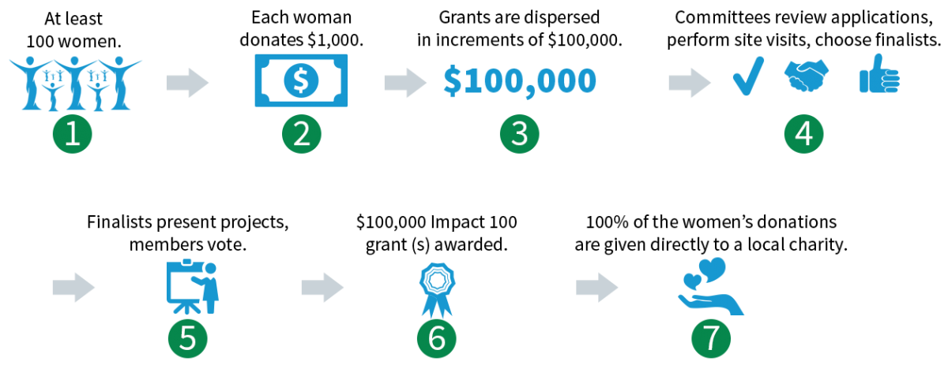
How Does it Work?

Slide 4
We are not alone…
There are more than 50 other chapters of Impact 100 in the U.S. and Australia
By the end of 2017, Impact Groups in the U.S. had granted more than $55 million, and the number is growing
In 2017, Impact Chapters Gave away more than $10 million
There are now three other chapters in New Jersey!
As we grow as an organization, we will be able to give additional grants.
Impact100 Essex is completely independent – we decide how we operate, and we will adjust as time goes on according to the needs of Essex County

Slide 5
Eligibility Requirements

Slide 6
Organizations must operate within Essex County, NJ, and have:
501 (c)(3)
Track record of success
At least three years in operation
Annual operating budget of at least $100,000
At least 2 years of independently prepared financial statements

Slide 7
We Are Looking For:
Projects in Essex County with high impact – new projects or expansion of existing projects
Projects addressing under-met needs, empowering an underserved constituency
Projects that innovate, deepen or expand an existing mission, resulting in measurable, sustainable change
A Plan to spend the grant within 2 years, and evidence that all funding needs will be met.
Evidence that the idea is effective – show us your research!

Slide 8
We are NOT interested in:
Lobbying, partisan or religious projects
Debt reduction, interim or bridge funding, endowments or fundraising
General operating expenses or overhead
Grants to individuals

Slide 9
Finalists and Semi-Finalists in 2017:
Clearly demonstrated need
Showed us why you were the organization to meet that need
Showed us you were ready to get to work
Had clear budgets and program plans
Gave us confidence that you could handle the additional work and money
INSPIRED US!

Slide 10
Many projects were less successful when:
We weren’t sure what the project was
We weren’t sure where/how you planned to spend our money
The request seemed to be to continue ongoing operations
Necessary partners were not yet identified/secured
Additional funding necessary was not yet secured (or we couldn’t tell where it was coming from)
Funding seemed unnecessary
Staffing seemed inadequate, or there was not a clear plan to achieve needed staffing
We weren’t inspired.

Slide 11
APPLICATION 2018
HELPFUL HINTS

Slide 12
Proposed Project Description and Methodology
Project Title/Name and one sentence description
Statement of Need
Summarize the challenge your project aims to solve. Cite and share data that help to
frame the challenge.
Project Summary
Provide an overview of the project and the impact you expect will result. Inspire us!
Project Goals/Deliverables/Impacts
Please share your SMART goal(s) here
(Specific, Measurable, Attainable, Relevant and Time-bound)
deliverables and timelines that align with the SMART Goals. *
Rationale: Please share why you have chosen this particular approach or strategy to address the challenge you discussed in your statement of need. For example, are you launching an approach locally that has demonstrated success elsewhere? Are you trying an innovative approach to an intractable problem?

Slide 13
Project Evaluation Define how you will measure success. How will we know if the program has achieved or is on target to achieve the impact you have described?
Readiness: We hope to see our funds quickly begin to impact Essex County. If you received these funds around February 2019, is there anything that would prevent you from beginning the project immediately? Examples include but are not limited to: permits for renovations/construction, approvals, permissions from School Boards or Unions, new hires.
Sustainability How would the project sustain itself after two years if you receive Impact100 Essex funding?

Slide 14
Project Budget
the total project budget with a detailed use of funds and show how the funds will be allocated within no more than a two-year time frame (one year is fine).
source of other revenue including indication of what is already acquired and what needs to be acquired.
a small narrative to accompany your budget that includes
any explanation that might be needed to clarify items in your budget attachment;
a description of how Impact100 Essex’s funds will be used for this project;
an indication if the cost of assessing the program as you described in the evaluation section will be covered by this grant or with other funds; and
a statement of whether or not you need additional resources to begin this project and if additional resources are needed, please explain what those resources are, quantify them as appropriate, and describe how and when you intend to obtain them.

Slide 15

Who has ever had a goal you couldn’t complete?

Slide 16



S.M.A.R.T. Goals are:
Easy to understand
Clear Point of Success

Slide 17
S.M.A.R.T Goals are:
Specific
Measurable
Attainable
Relevant
Time bound

Slide 18
A Brief Guide to S.M.A.R.T. Goal Setting
Specific
The goal must clearly state what is to be achieved, by whom, where and when it is to be achieved.
Sometimes it may even state why that goal is important.
NOTE: Not all of these questions will apply to every goal … but it is important to ask all the questions in order make it as clear as possible.

Slide 19
A Brief Guide to S.M.A.R.T. Goal Setting
Measureable
It answers the question of quantity - how much, how often, how many?
Measurability applies to both the end result and the milestones along the way to attaining a goal.
The milestones are signs along the way that will tell you that you are on the right track to achieving your goal.

Slide 20
A Brief Guide to S.M.A.R.T. Goal Setting
Attainable
Goals must be achievable.
If you set goals that even you don’t believe in it is very unlikely you will achieve them.
This is equally important when setting goals for a group, such as a team
The process of setting S.M.A.R.T. goals ensures that the necessary buy-in to the goals is in place
NOTE: While the goals must be possible, be careful that you do not limit yourself based on what other people believe to be achievable

Slide 21
A Brief Guide to S.M.A.R.T. Goal Setting
Relevant
Your goals must be relevant to what you want to achieve in the short term and the long term.
Understanding your organization’s or personal vision, mission and purpose is critical in this respect.
Do those things that are most important and in line with your long term vision and mission.

Slide 22
A Brief Guide to S.M.A.R.T. Goal Setting
Time-Based
This sometimes overlaps with the goal being Specific, but it aims to ensure that you put a time-frame to your goals.
Deciding by when you want to achieve something can be a good motivator. It can prevent you from procrastinating because you know that you are working to a deadline.
NOTE: Someone said a goal is a dream with a time-frame to it

Slide 23
S.M.A.R.T. Goal Setting - Template
 | Big Vision | Specific | Measureable | Attainable | Relevant | Time-Based
Prompting Questions → | What do you want to achieve? | Who? What? Why? Where? | How Much? How Often? How Many? | Is this achievable? | How is it important to what you want to ultimately achieve? | By When?
S.M.A.R.T. Goal #1
S.M.A.R.T. Goal #2
Pair and Share - Draft initial S.M.A.R.T. goals

Slide 24
June 27 Applicant Info Session
6/27/18
Application Available
6/27/18
Applicant Info Session
Waterfront Recreation Center
2 Grafton Ave,
Newark
10-11:30 am
September 14 Application Due
9/14/18
Application Due
Grant Committee reviews applications
Site Visits of semi-finalists
10/29-11/9
January 15
Membership Meeting
Finalists notified
December Finalists
October/November Review
Finalists prepare presentations
December 1
Finalist Presentations
Members Vote
2018 Grantee Announced

Slide 25
Impact100 Essex 2017 application link via Foundant/cfnj:
https://grantinterface.com/Home/Logon?urlkey=cfnj
If you submitted an application last year you can use the same account. If not, you will need to set up an account, and then you will have access to the application.

